Slide 1
Student exam scheduler
Team:
Ioana Chelaru
Stefan cîrstea

Slide 2
description
This project automates the exams scheduling process by creating an event in the specified Google Calendar account for each exam of the given student. The data is provided by the university's website. The robot is used for each student identified by specialization, year of study and e-mail address.
Input: .doc file with the exam dates, the specialization, year of study and e-mail address of the given student
Output: the Google Calendar is updated with the newly created events according to the exams planification
Apps: MS Word/Excel, browser, mail

Slide 3
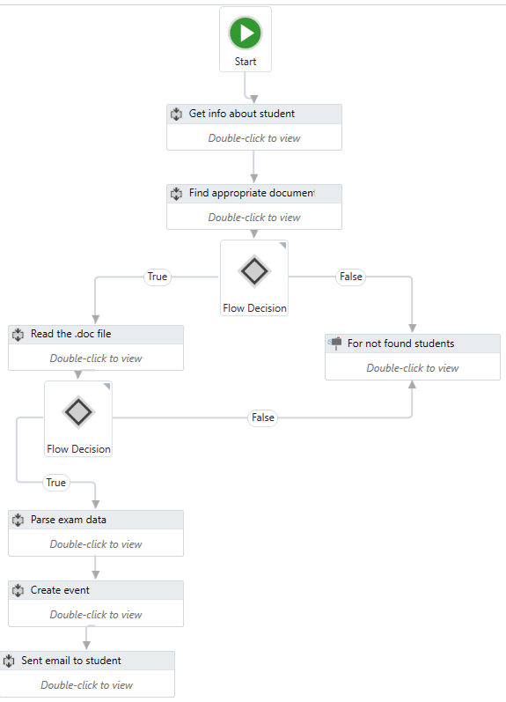

Slide 4
Exceptional situations
The first situation we encountered was the one in which the field and year of study of the student couldn't be found in the university's files. To treat this case, we used a flow decision activity in which we check with the help of a boolean variable if the student was found.
Another problem we found was that if the student was in a terminal year, then he would have some optional subjects and we couldn't know which subject he has chosen from the many available. Furthermore, the university's files do not provide any exam dates for those subjects. In solution, we decided to include a warning message in the email we sent to the user.

Slide 5
Exceptional situations
The last special case we stepped upon was the one in which the student has, somehow, misspelled the number of his class and we could not find it in the university file. As a solution, we decided to show a message to let the user know the problem and, perhaps, fix it.

Slide 6
challenges in the implemetation
Our biggest challenge was to find out how to create a new event in the Google Calendar. We've done our research regarding the issue, but none of the sources and examples we found could clarify the process for us.
Another challenge for us was to figure out how to read the .doc file and parse the text so it would be easier for us to work with it.

Slide 7
conclusions
We are proud of what we achieved, although your project isn't finished and our goal is not yet achieved.
We enjoyed learning to use UiPath, because it is really different to what we had experienced so was in the years of university.

Slide 8


